Slide 1
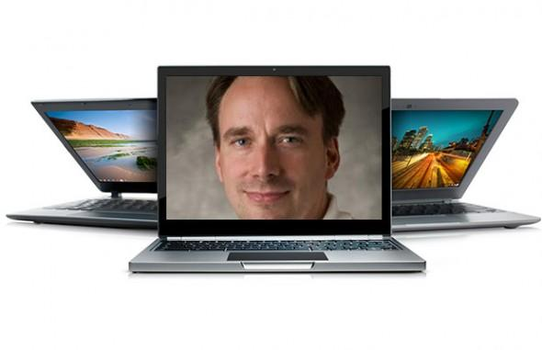


Linux Boot Camp
Yunju Baek

Slide 2
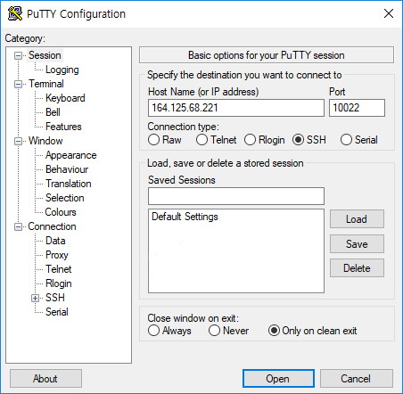
Connecting
SSH
Windows users: PuTTY (http://www.putty.org/)
Mac/Linux users: Use ‘ssh’ command at terminal
Server : csedell.pusan.ac.kr
IP: 164.125.254.66 (교외접속)
IP: 10.125.68.221 (교내접속)
Port: 8022
Username: 학번
PW: 학번(최초접속시 반드시 바꿀것)
You have 1GB storage space.
$cd
$du --max-depth=0 -h ~/
31M /home/201812345/
You must change your password ASAP!

Slide 3
Change Password
$ passwd
(current) UNIX password:
Enter new UNIX password:
Retype new UNIX password:
passwd: password updated successfully

Slide 4

Change Password
$ passwd
(current) UNIX password:
Enter new UNIX password:
Retype new UNIX password:
passwd: password updated successfully
You must change your password ASAP!

Slide 5
File Transfer
winscp
https://winscp.net/eng/docs/lang:ko
Mac/Linux users: Use ‘scp’ command at terminal
$ scp username@SERVERIP:[RemoteFilePath] [LocalFilePath]
$ scp [LocalFilePath] username@SERVERIP:[RemoteFilePath]

Slide 6
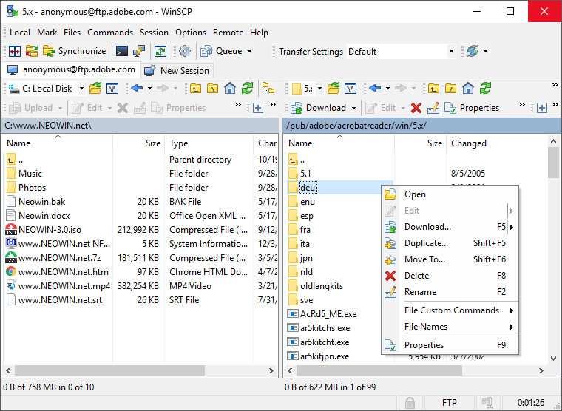
File Transfer
winscp
https://winscp.net/eng/docs/lang:ko
Mac/Linux users: Use ‘scp’ command at terminal
$ scp username@SERVERIP:[RemoteFilePath] [LocalFilePath]
$ scp [LocalFilePath] username@SERVERIP:[RemoteFilePath]

Slide 7
Some Nice Terminal Shortcuts
Pressing tab will autocomplete file and folder names!
Control+C will stop execution of your current program!
Control+R will let you search your command history!
Control+L will clear your screen!
cmd arg1 … argN > file1.txt will put the output of cmd into file1.txt!
cmd arg1 … argN < file2.txt will pull the input of cmd from file2.txt!
Use the up and down arrow keys to scroll through your command history!

Slide 8
Linux file pathing
~ is your HOME DIRECTORY
This is where you start from after you SSH in
On bash, you can also use $HOME
. is an alias for your PRESENT WORKING DIRECTORY!
.. is the file path for the PARENT DIRECTORY of your present working directory!
/ is the file path for the TOP-LEVEL DIRECTORY
You probably won’t use this too much in this class

Slide 9
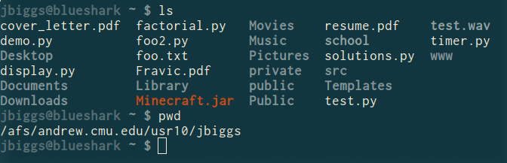
ls <dir> - LiSt
Lists the files in the present working directory, or, if specified, dir.
pwd tells you your Present Working Directory.

Slide 10
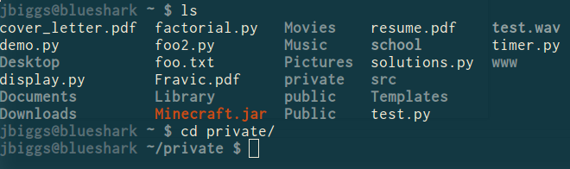
cd <directory> - Change Directory
Changes your present working directory to directory
Your main tool for navigating a unix file system

Slide 11
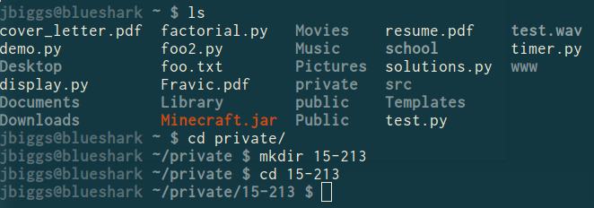
mkdir <dirname> - MaKe DIRectory
Makes a directory dirname in your present working directory.
Directories and folders are the same thing!

Slide 12
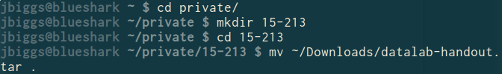
mv <src> <dest> - MoVe
cp works in exactly the same way, but copies instead
for copying folders, use cp -r
dest can be into an existing folder (preserves name), or a file/folder of a different name
Also used to re-name files without moving them
src can be either a file or a folder

Slide 13
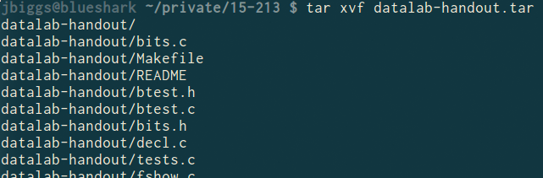
tar <options> <filename> - Tape ARchive
Compression utility, similar to zip files on Windows
For full list of options, see man tar
As name suggests, was used on tapes!
x - extract, v - verbose, f - file input
All of our handouts will be in tar format.
Do not let the Windows WinZip program open up your .tar file!

Slide 14
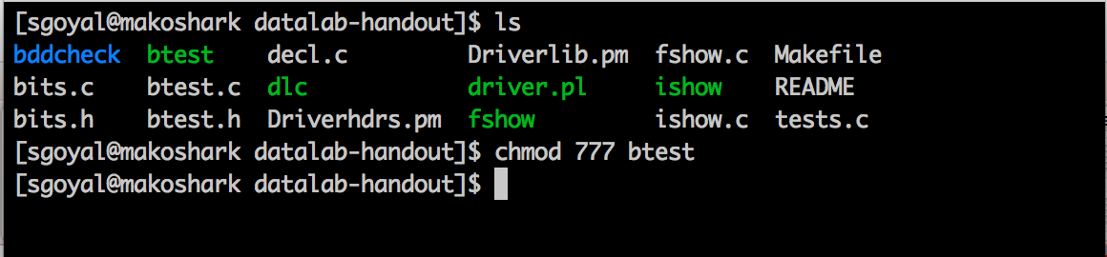
chmod <permissions> <src>
chmod is used to change the permissions of a file or directory.
777 will give all permissions
src can be either a file or a folder

Slide 15
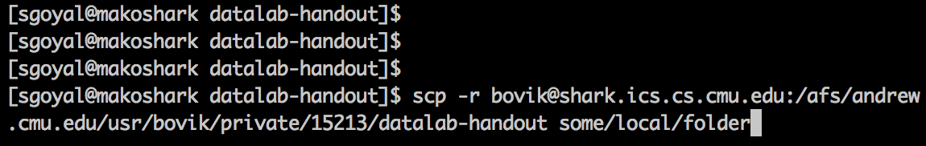
scp <src> <dest>
Allows files to be copied to/from or between different hosts.
The full path to the remote host needs to be specified
Use the -r option to copy folders
scp –r userid@serverip:/full_file_path <dest>

Slide 16
rm <file1> <file2> … <filen> - ReMove
Essentially the delete utility
To remove an (empty) directory, use rmdir
To remove a folder and its contents, use rm -rf
Please be careful, don’t delete your project.
There is no “Trash” here. It’s gone.
If someone asks you to use rm –rf / ignore them

Slide 17
What’s in a file? (using cat)
cat <file1> <file2> … <filen> lets you display the contents of a file in the terminal window.
Use cat -n to add line numbers!
You can combine multiple files into one!
cat <file1> … <filen> > file.txt
Good for seeing what’s in small files.
Try cat -n bits.c. Too big, right?

Slide 18
What’s in a file? (using less)
less <file> will give you a scrollable interface for viewing large files without editing them.
To find something, use /
To view the next occurrence, press n
To view previous occurrence, press N
To quit, use q

Slide 19
What’s in a file? (using grep)
grep <pattern> <file> will output any lines of file that have pattern as a substring
grep -v will output lines without pattern as substring
grep -R will search recursively
Try it: grep ‘bitXor’ bits.c
grep -v ‘*’ bits.c
grep -R ‘unsigned’ .

Slide 20
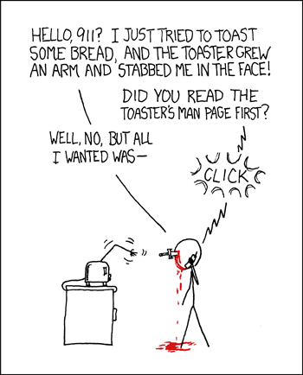
man <thing>
What is that command? What is this C standard library function? What does this library do? Check to see if it has a man page!
Pages viewed with less
Try it!
man grep
man tar
man printf
man strlen

Slide 21
Vim (vi – improved) Basics
Some different modes:
Normal mode:
The first mode you enter. Hit the escape key to return to this mode at any time
Everything entered here is interpreted as a command
Command-line mode:
Used for entering editor commands (necessary to save file & quit the editor)
Enter “:” in Normal mode to get to this mode
Insert mode:
To edit text
Enter “i” in Normal mode to get to this mode

Slide 22
Vim Basics
Useful commands:
Copying/pasting/deleting lines:
yy (yank) or 5 yy (yank next 5 lines)
dd (delete) or 5 dd (delete next 5 lines)
p (paste)
Search (/search_string or ?search_string)
Useful editor commands:
Write (w)
Quit (q) quit no-save (q!)

Slide 23
(Backup) vi editor
입력모드
입력모드 종료
Esc 키
키
수 행
i
텍스트가 커서 앞에서 삽입
a
텍스트가 커서 뒤에서 삽입
o
텍스트가 현재 줄 다음부터 삽입
r
한 문자 대치

Slide 24
(Backup) vi editor
명령모드 – 커서이동
입력모드에서 “ESC” 키를 눌러 명령모드로 전환해야 아래의 내용을 사용할 수 있음
키
이 동
, k
한 줄 위로
, j
한 줄 아래로
, l
한 문자 오른쪽으로
, h
한 문자 왼쪽으로
b
한 단어 앞으로
w
한 단어 뒤로
:$
마지막 줄로
:5 라고 하면 5번째 줄로 감
:nn
nn 줄로
Control-f
한 화면 밑으로 이동
Control-b
한 화면 위로 이동

Slide 25
(Backup) vi editor
명령모드 – 삭제
명령모드 – Undo and Redo
키
키
x
한 문자 삭제
dw
한 단어 삭제
dd
한 줄 삭제
블록 선택
Shift + v
키
키
u
Undo (실행 취소)
ctrl+r
Redo (다시 실행)

